Slide 1
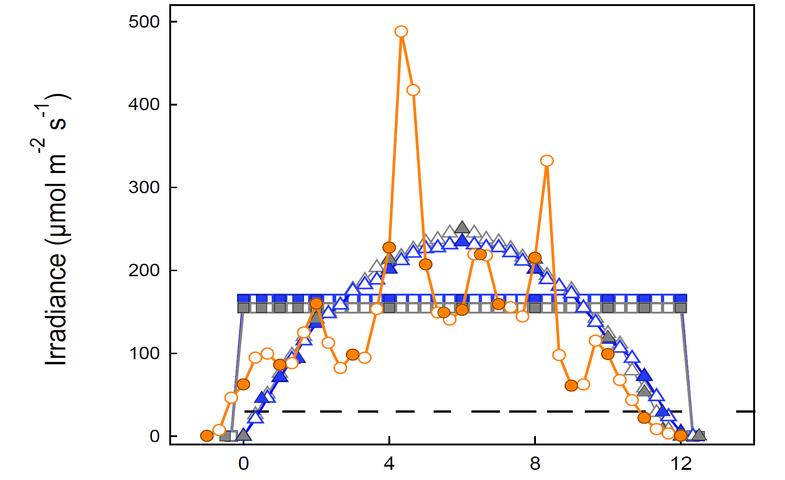
gray square symbols (LED square):

Slide 2
Blue triangle symbols (fluorescence sinusoidal):

Slide 3
gray triangle symbols (LED sinusoidal):

Slide 5
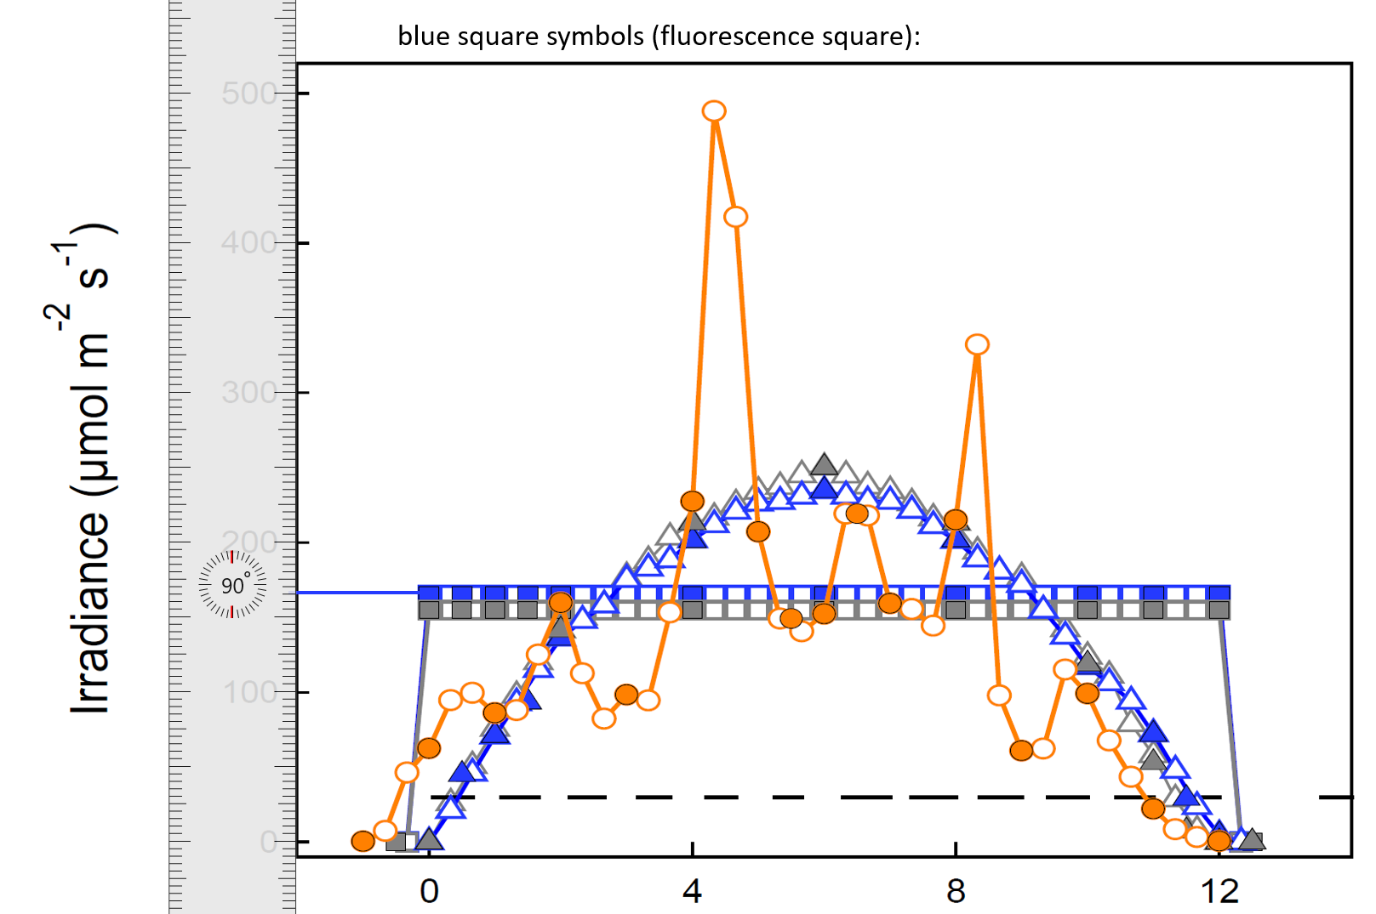

Slide 6
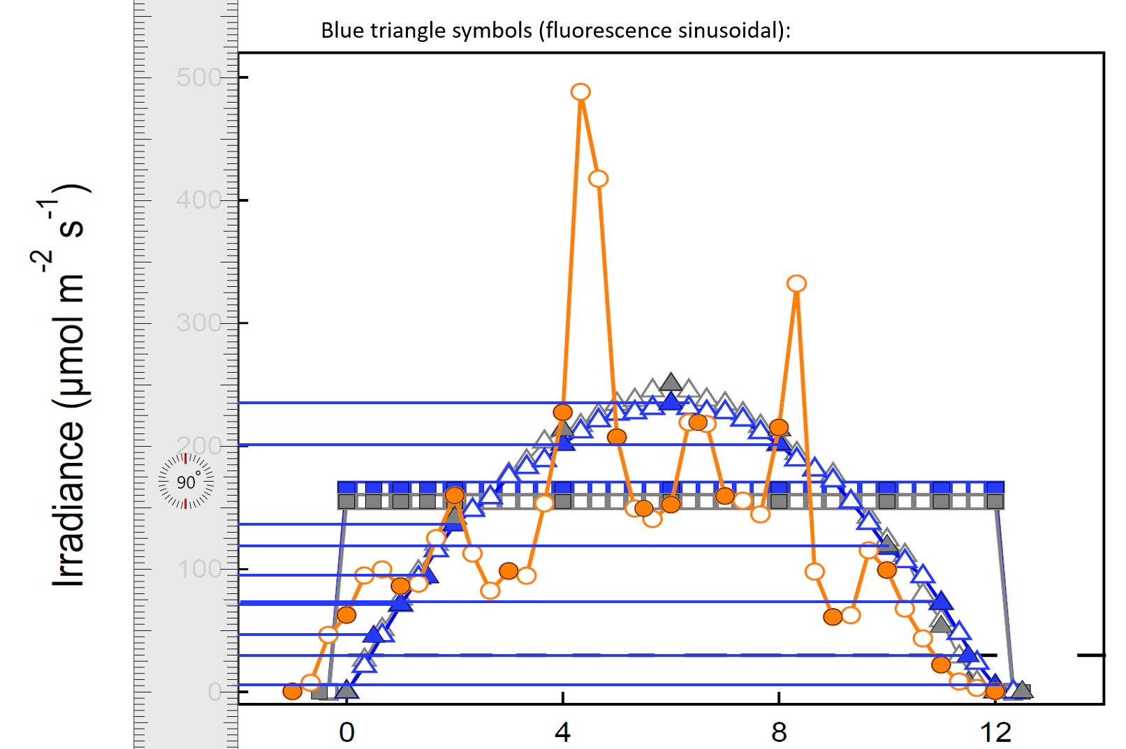

Slide 7
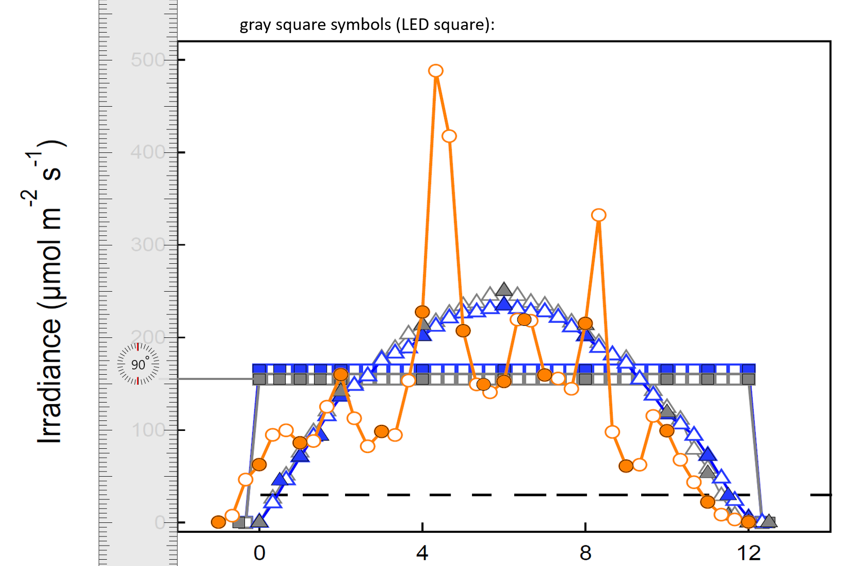

Slide 8
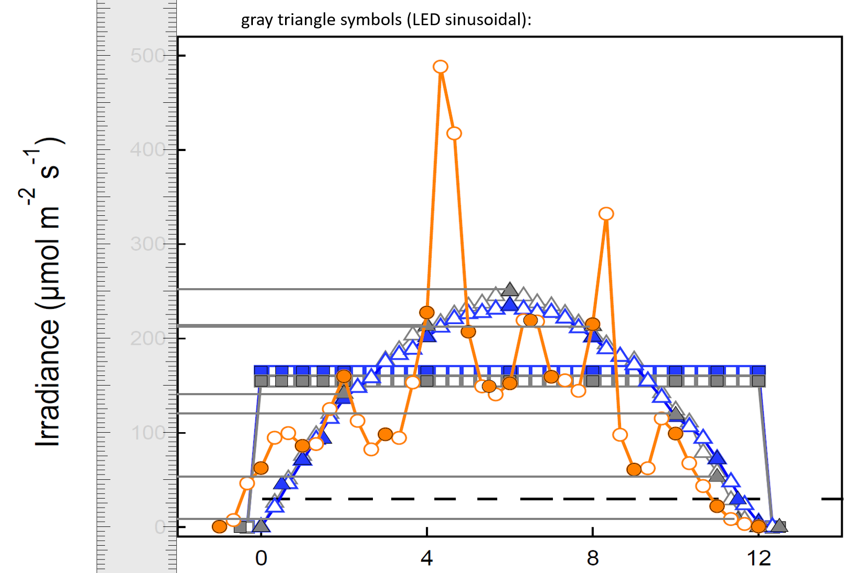

Slide 9
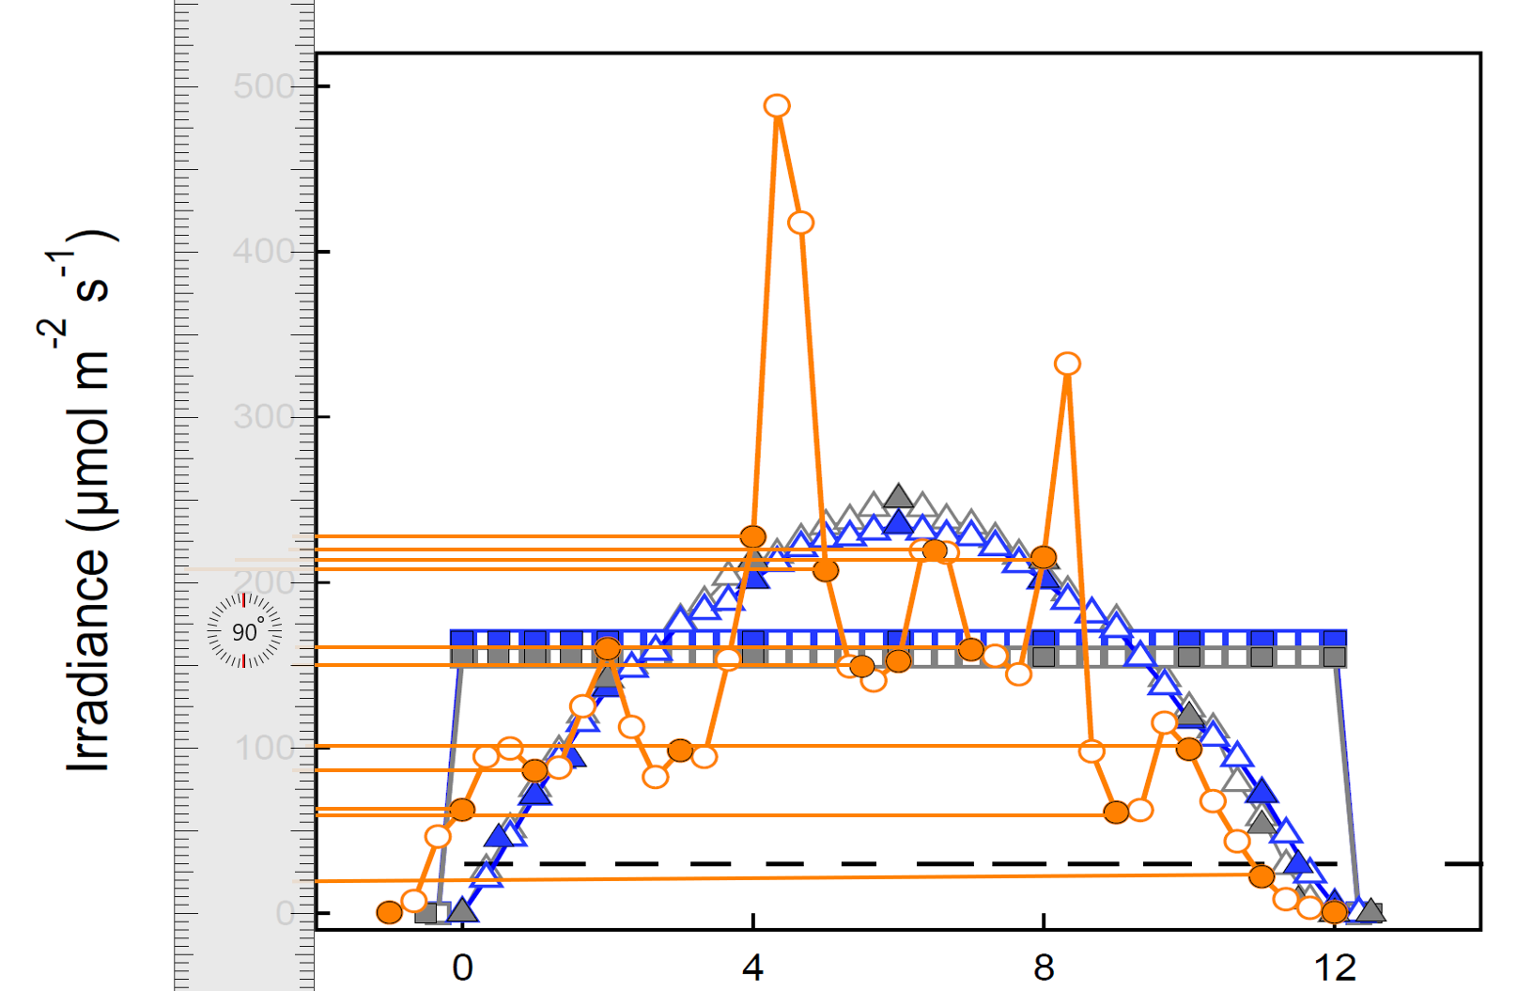

Slide 10
Blue triangle symbols (fluorescence sinusoidal):

Slide 11
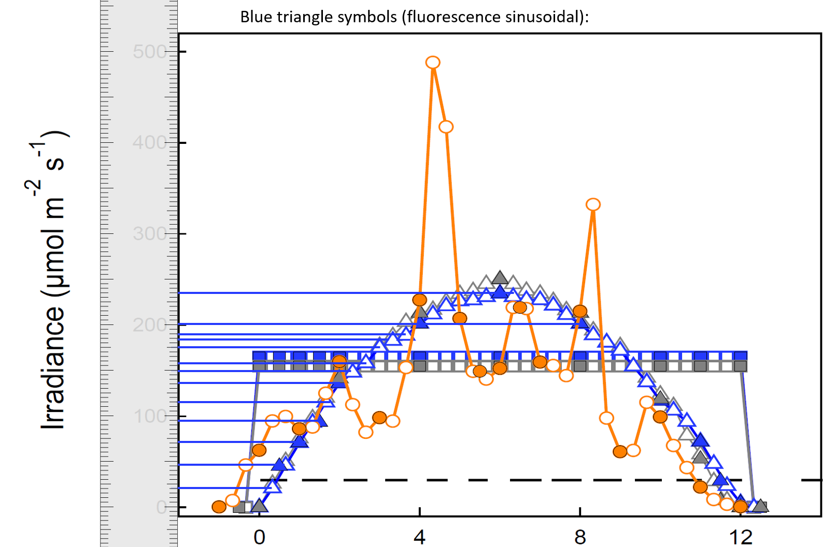

Slide 12
